Slide 1

CREATING AN APP
Week 2 : App development
Created by : Tjaš Jelen & Nik Jovan

Slide 2
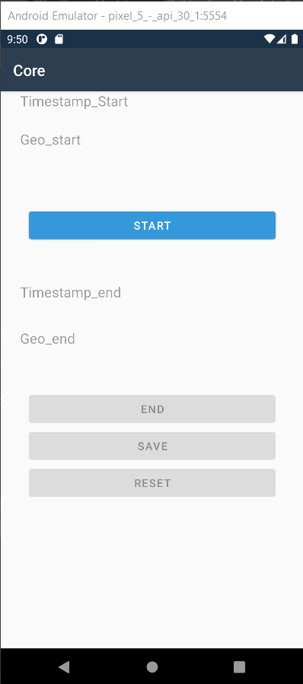
The App
Captures the time and geolocation of the user(„check in“ for construction site employees)
Does this through the START, END and SAVE button
Information gets saved by pressing the SAVE button
It is saved into the device and into the database when online
The RESET button resets the parameters(timestamp, geolocation)
Main librarary needed for geolocation was Xarmin.Essentials

Slide 3


Software Used
Enviroment used: Visual Studio
Tool used: Xamarin Native for Android
Programing language: C#
Database: MySQL

Slide 4

Timestamp
Saves arrival and departure time of user at site
User can‘t tamper with time by changing the time in the phone settings, because time is from GPS

Slide 5
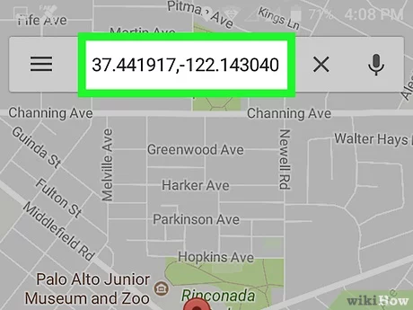
Geolocation
Saves latitude(N) and longtitude(E) of user
Triggers with START and END button and then SAVE
Retrieves time through GPS

Slide 6
Save and Reset
SAVE button works only after END button is clicked
Stores data into a file in the device(txt file)
Stores the data into the database
RESET button resets timestamp and geolocation
We used MySQL for the database

Slide 7

Database
Used MySQL database
Created a new database on our own web server
Created our table for data
Connected our project with the database with MySQLConnector
Wrote code for data to be sent to database(insert into…)

Slide 8
Extra functionalities
App detects if you have WiFi
Locked button press order(first START END SAVE)
Message shown if no location(„NO GPS!“)

Slide 9
THANK YOU FOR LISTENING!
Presented by : Tjaš Jelen and Nik Jovan

